Slide 1

MDBI Smart Automation Hackathon

Slide 2
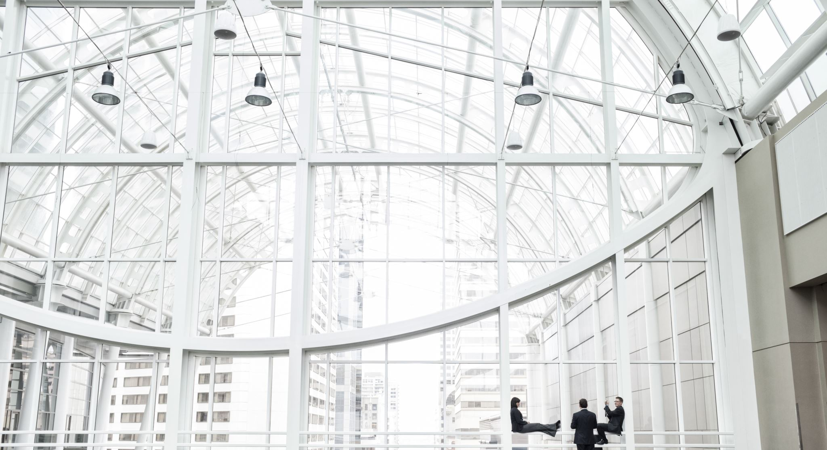
MDBI Smart Automation Hackathon
Event Details: * Date and Time: Wednesday, January 22, from 3:00 to 6:00 PM * Location: Rooms V-401/V-402, Velázquez 130 building

Slide 3
Agenda
Introduction
(3:00 PM - 3:15 PM):
Welcome and introduction to the hackathon’s objectives.
Brief overview of Generative AI and its applications.
Challenge Definition and Team Formation (3:15 PM - 3:30 PM):
Identification of common, time-consuming business processes.
Formation of multidisciplinary teams to foster collaboration and diverse ideas.
Technical Tools (3:30 PM - 4:00 PM):
Tools Primer: introducing participants to OpenAI's advanced AI tools, Make.com's and other low-code / no-code tools.
Solution Development
(4:00 PM - 5:15 PM):
Teams work on ideating and developing their solutions.
Continuous support and guidance provided throughout the process.
Project Presentations (5:15 PM - 5:45 PM):
Each team presents their solution.
Evaluation of solutions by a panel of judges.
Closing and Recognition (6:00 PM - 6:15 PM):
Summary of the ideas presented and selection of outstanding projects.
Prize distribution and closing remarks.

Slide 4
Challenge Definition and Team Formation (3:15 PM - 3:30 PM)

Slide 5
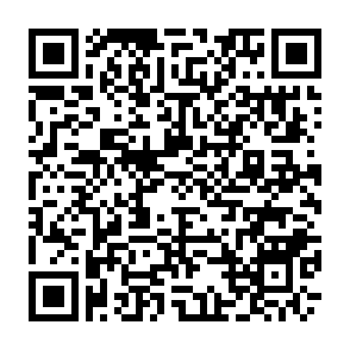
Challenge Definition and Team Formation (3:15 PM - 3:30 PM)
Write down various business processes (e.g., "Invoice Processing," "Customer Service Inquiries," "Inventory Management," etc.) on index cards.
(5 minutes)
Volunteers to present their initial ideas about which business processes might be common and time-consuming.
(2 minutes each)
Other students can choose to join the volunteer's idea using ink below or present their own in the next round of volunteers.
http://bit.ly/3CbuUSj

Slide 6
Technical Tools No Code / Low Code (3:30 PM - 4:00 PM)

Slide 7
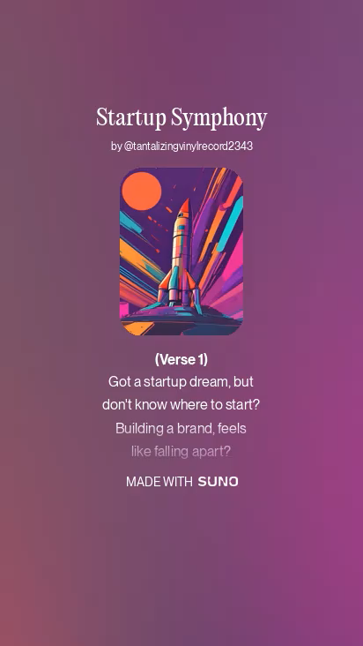
Technical Tools (3:30 PM - 4:00 PM)

Slide 8



Opportunities
PRODUCTIVITY / AGILITY
COST SAVINGS
COLLABORATIVE

Slide 9
Let's seize opportunities
65%
Delayed application development
65% of organizations report delays in application development.
.
37%
Paper-based processes
37% of organizations still use paper to Critical business processes.
69%
Accelerating innovation and digital transformation 69% of organizations say accelerating digital innovation and transformation is the number one reason they adopted low-code application development.
Fo resterDigitalProcessAutomationSurvey,Q1. DresnerAdvisoryServices,.TheStateofBusinessInteligence,2018.

Slide 10
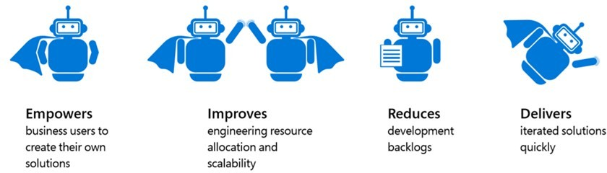
Low Code

Slide 11
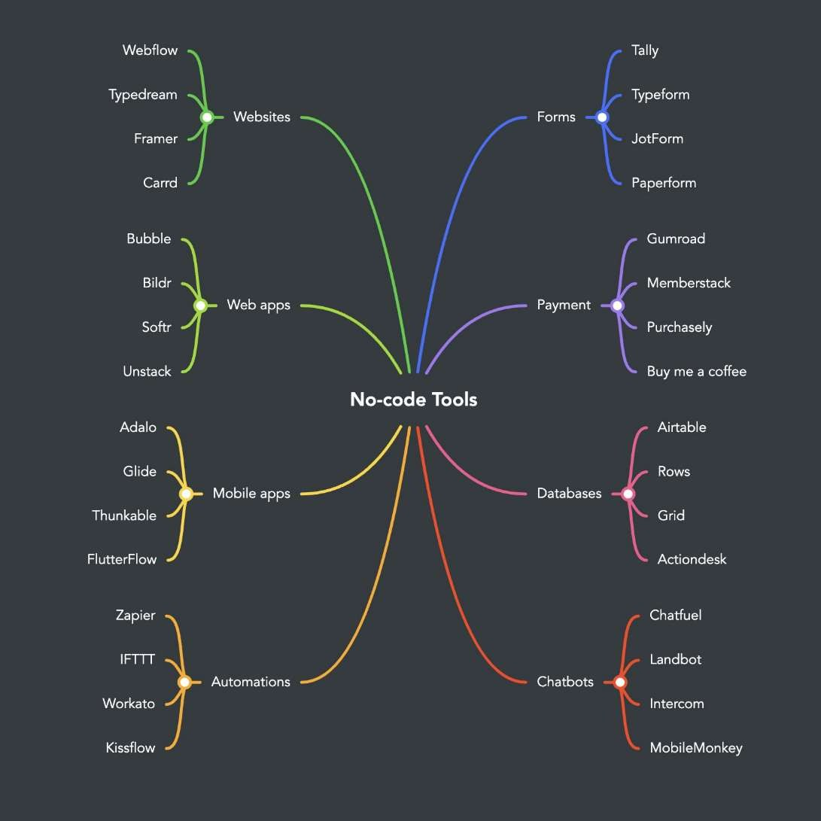
Map of no-code tools landscape
Low code solutions classified by field

Slide 12
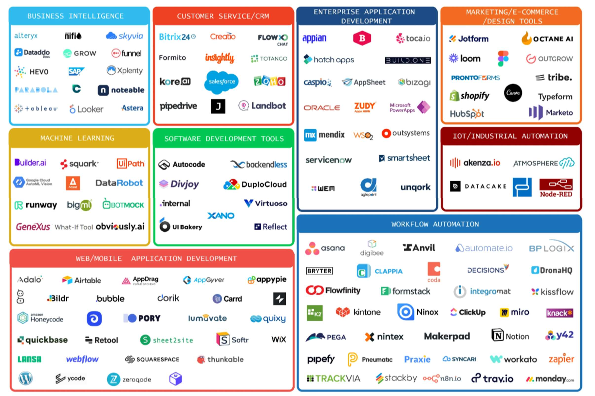
The low-code, no-code landscape
10 ⏐

Slide 13
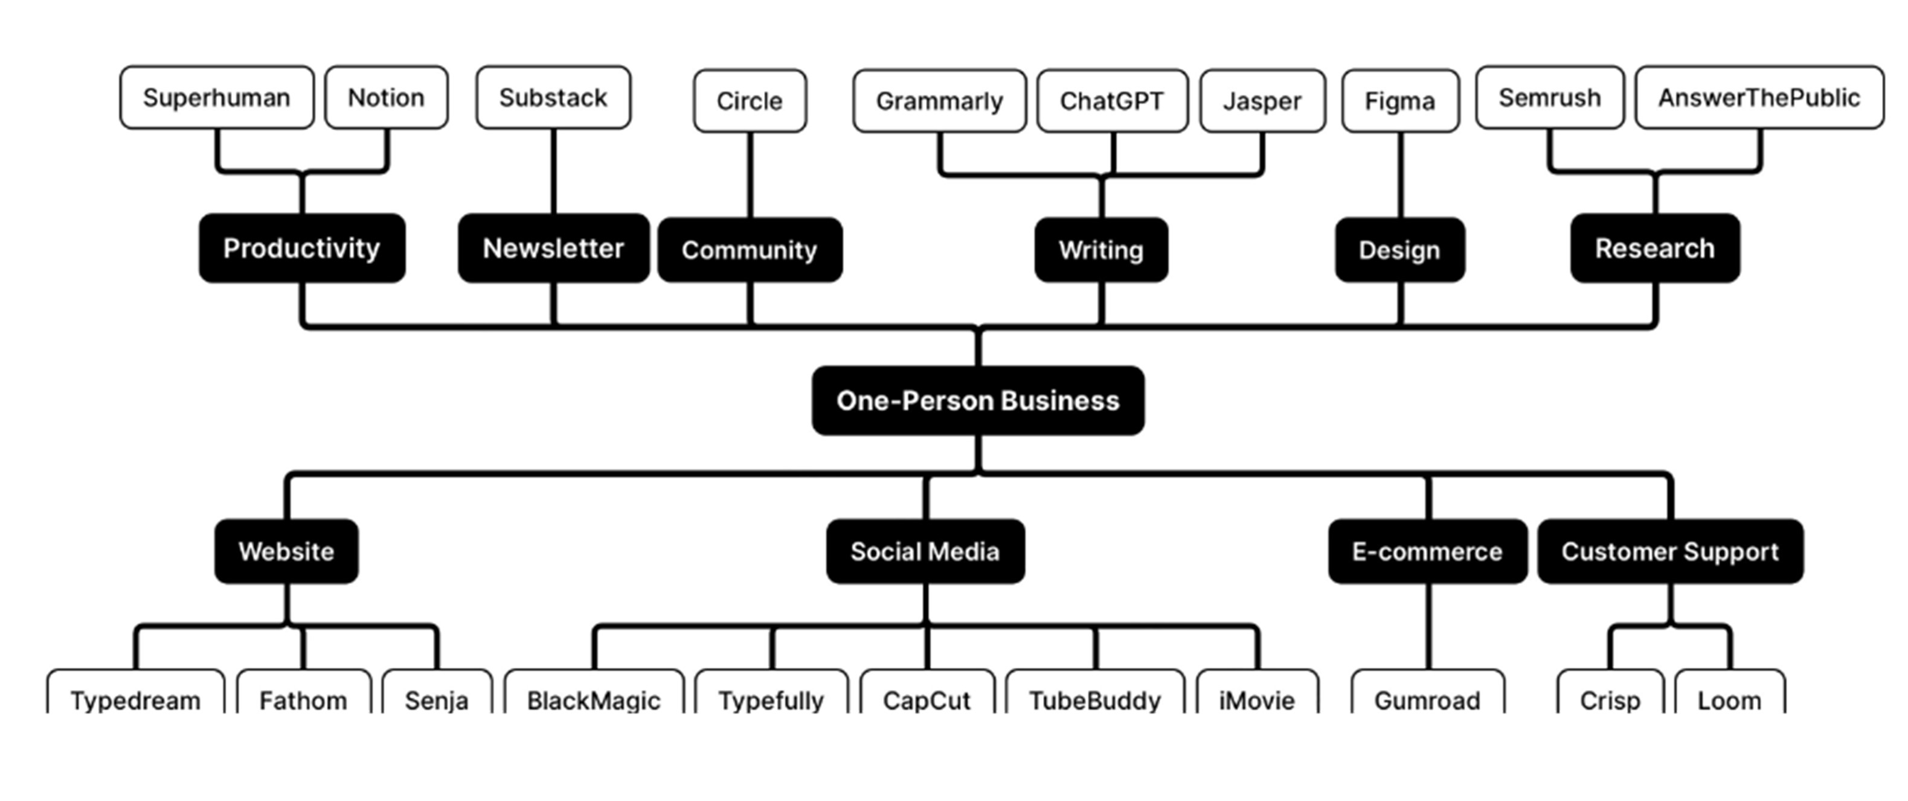
The no-code tools you can use to build a One-Person Business

Slide 14
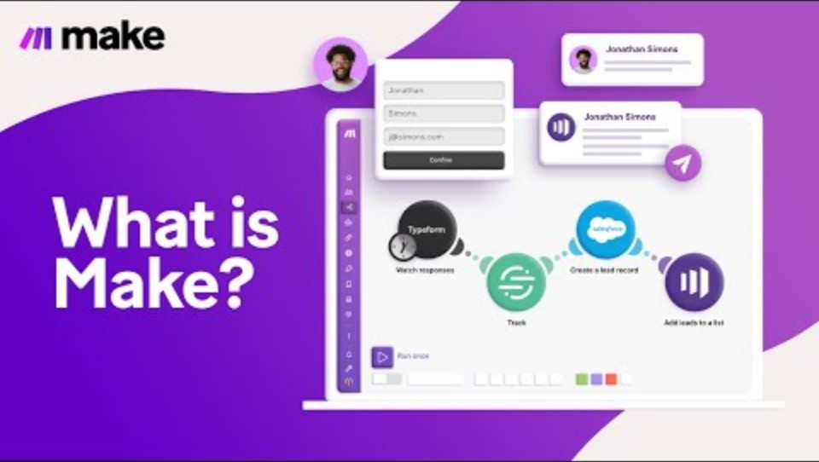
Low Code & RPA
17

Slide 15

Jingle with Suno AI

Slide 16
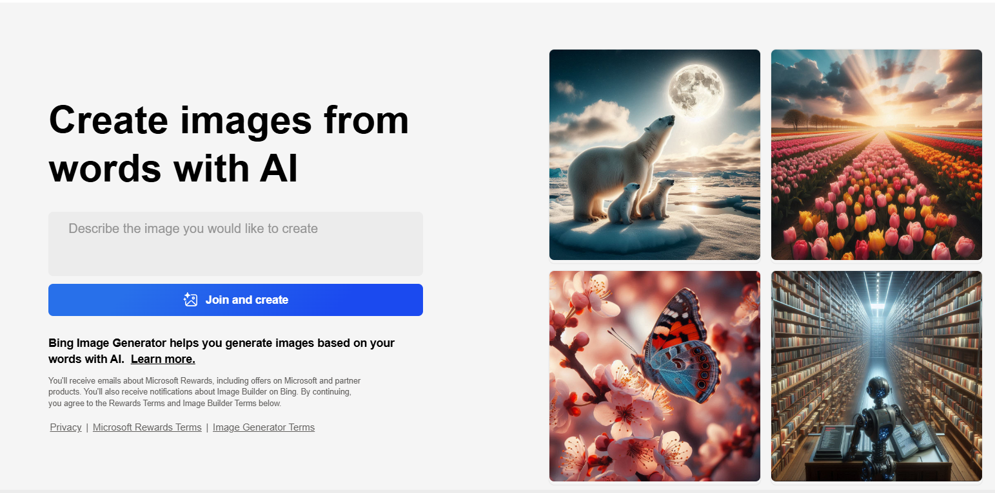
Logo with http://bing.com/create

Slide 17

Promo video with Synthesia.io

Slide 18
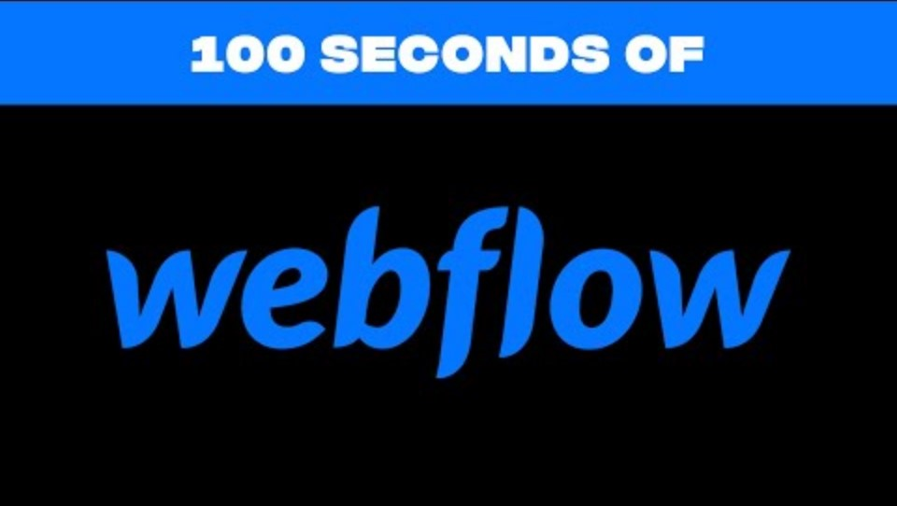
Website creation

Slide 19
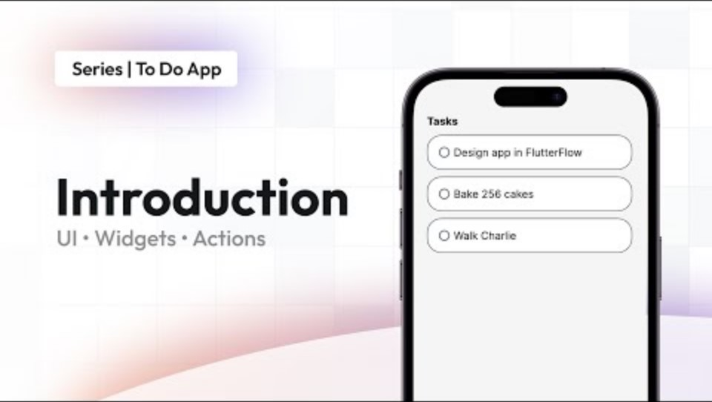
Mobile App Creation – Flutter Flow

Slide 20
Solution Development (4:00 PM - 5:15 PM):

Slide 21
Project Presentations - Deliverables (5:15 PM - 5:45 PM): - one minute to setup the presentation - deliver an impactful 4 minutes elevator pitch - everyone should speak - it should include: - logo - jingle (short) - promotion (short) - demo (short) - other parts in the Low Tech Demo (architecture optional). - 1-minutes Q&A session. - start on time, watch your pace

Slide 22
Project Presentations (5:15 PM - 5:45 PM):

Slide 23
Closing and Recognition (6:00 PM - 6:15 PM):

Slide 24
MDBI Smart Automation Hackathon

